Slide 1
Final project report
111061634 曾淳浩

Slide 2
Outline
1.Introduce convolution code and Viterbi decoding
2.System Architecture
3.HLS report
4.RISCV – vp report
5.Discussion problem

Slide 3
Viterbi decoder
Viterbi decoder is used to decode convolution code or trellis code.
The Viterbi algorithm is the most resource-consuming, but it does the maximum likelihood decoding.

Slide 4
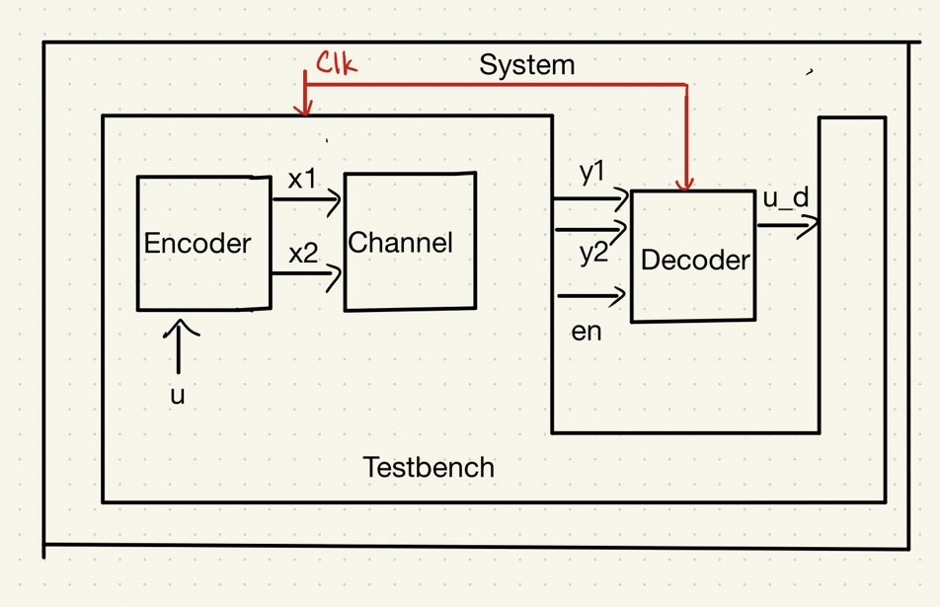
System Architecture

Slide 5
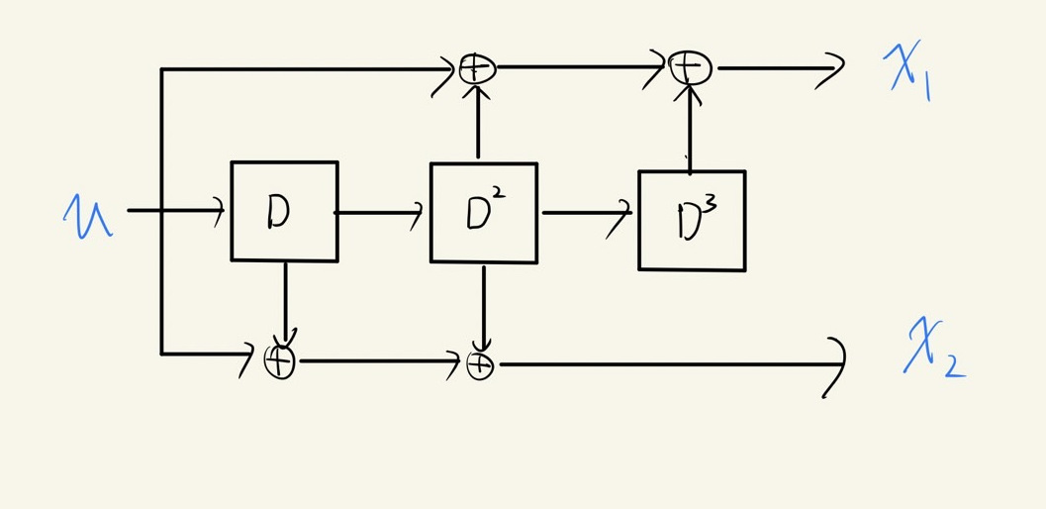
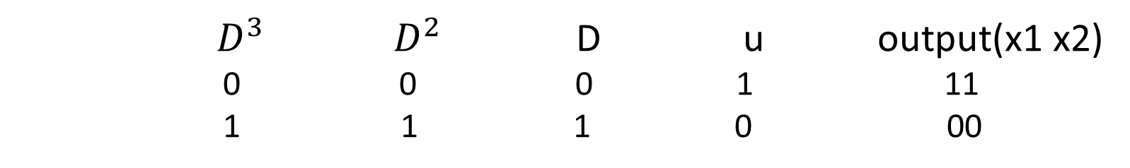
Encoder
(2, 1, 3) convolutional code
$$G\left(D\right)=(1+D^{2}+D^{3} 1+D+D^{2})$$
${ D}^{3}$ $D^{2}$ D u output(x1 x2)
0 0 0 1 11
1 1 1 0 00

Slide 6
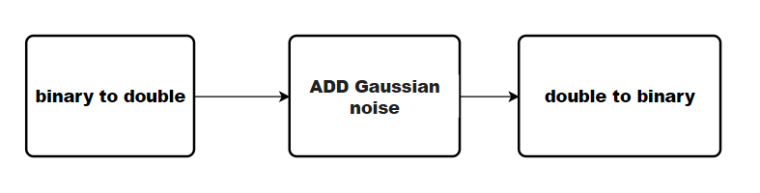
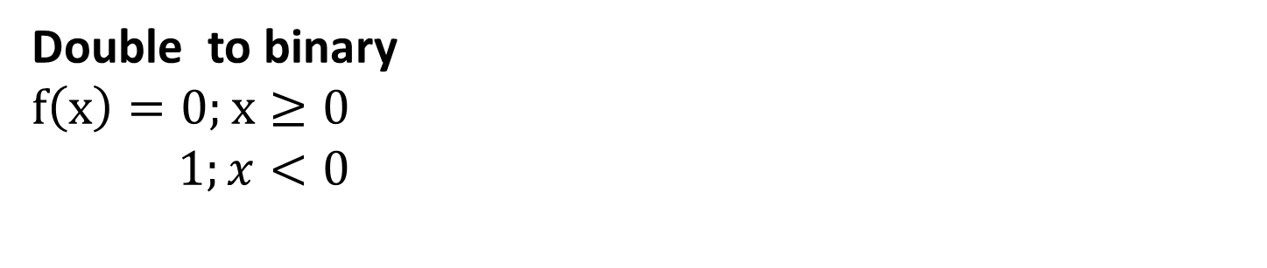
Channel
Double to binary
$$f\left(x\right)=0;x≥0$$
$$1;x<0$$

Slide 7
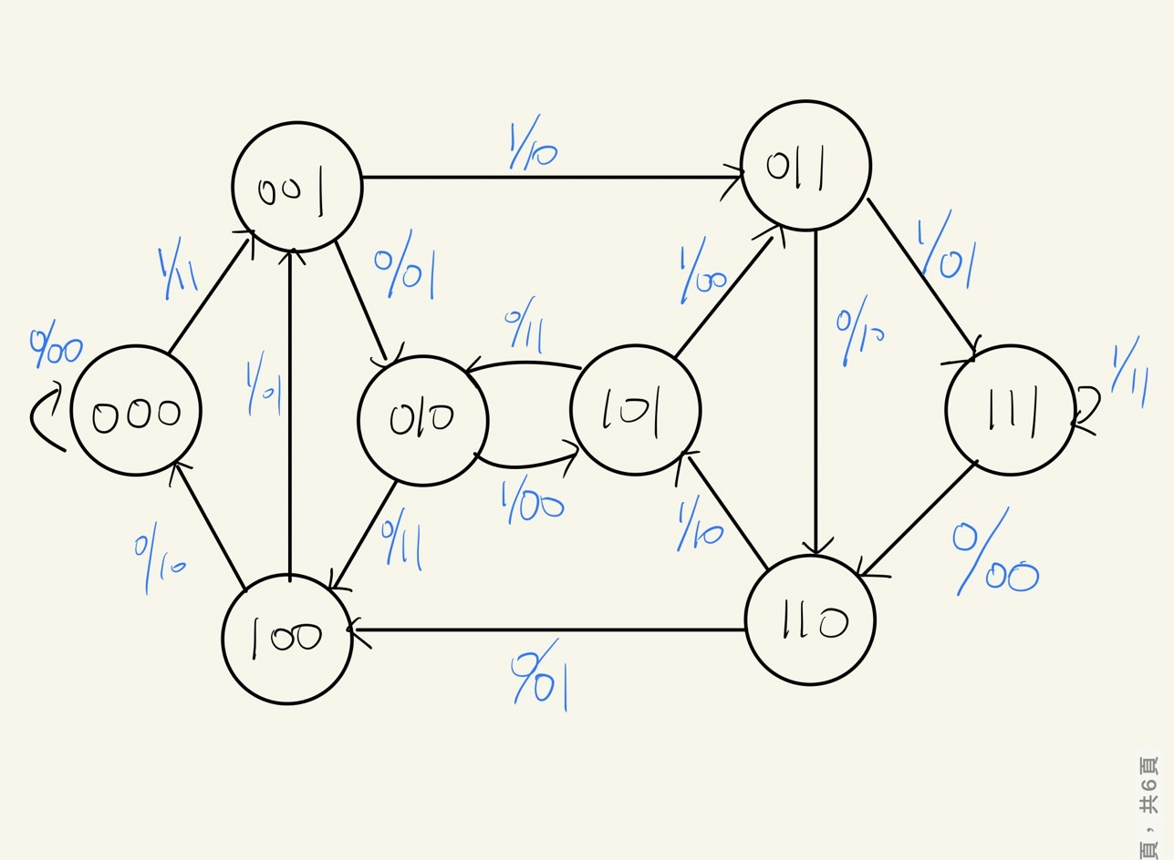
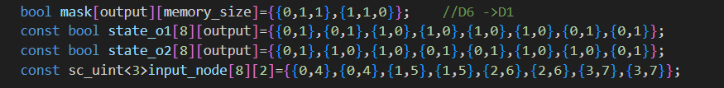
State diagram(decoder)
State diagram stores in Viterbi decoder let every nodes know output value and input node .

Slide 8
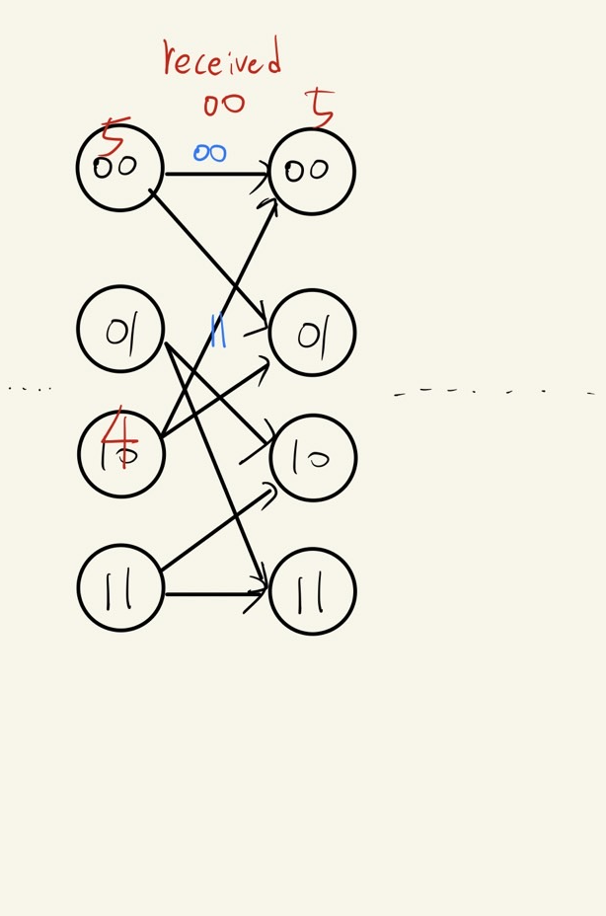
Algorithm
Repeat 8 times each cycle
1.Caculate hamming distance between received bits (after channel) and two input-nodes output.
2. Add hamming distance to input node’s accumulate path and choice small one.
3.Update accumulate path and decoded bits

Slide 9
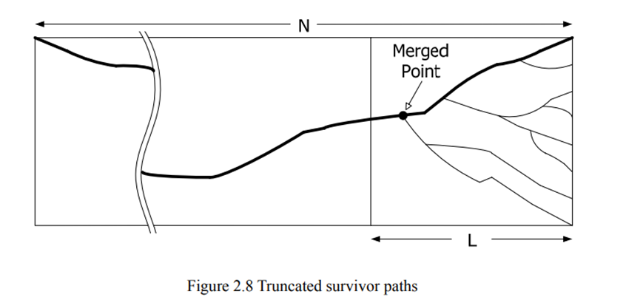
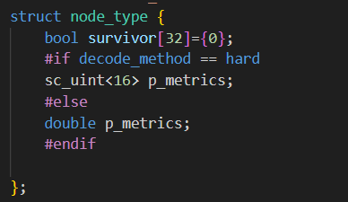
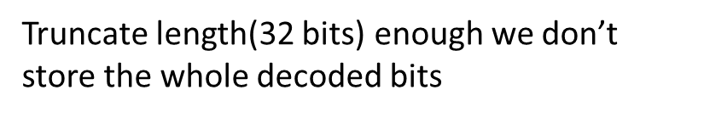
Memory in decoder

Slide 10
HLS report

Slide 11
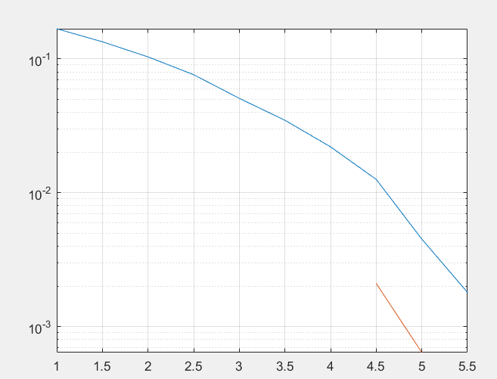
Behavior simulation
N = 50000bits
SNR (db) | Channel error | Decoded error | BER
1 | 12133 | 8400 | 0.1680
2 | 9767 | 5177 | 0.1342
3 | 7524 | 2537 | 0.0762
4 | 5513 | 1101 | 0.0348
5 | 3716 | 363 | 0.0125
6 | 2257 | 90 | 0.0018

Slide 12
RTL simulation version1
Clock cycle 10ns
N=50000 SNR= 3(dB)
 | Total run time | Area
BASIC | 1338596430ns | 40126.6
PIPE_LINE_UNROLL II=2 | 1501010ns | 12178.9
PIPE_LINE_UNROLL II=3 | 2001320 ns | 11458.9

Slide 13
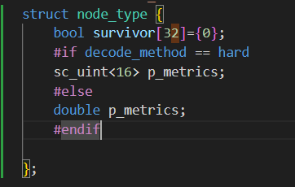
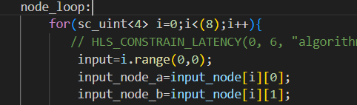
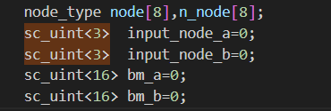
RTL simulation version2
1.Loop variable sizing
1.buffer sizing
 | Total run time | Area
BASIC | 1338596430ns | 37026.6
PIPE_LINE_UNROLL II=2 | 1501010ns | 8825.0
PIPE_LINE_UNROLL II=3 | 2001320 ns | 8353.7

Slide 14
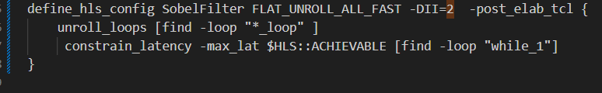
RTL simulation version3
1.Use latency constrain to while loop
 | Total run time | Area
BASIC | 938546430ns | 41026.6
PIPE_LINE_UNROLL II=2 | 1501010ns | 8825.0
PIPE_LINE_UNROLL II=3 | 1501010ns | 7421.8
同時做pipe line (II=3)和latency constrain 會將時間壓縮到與(II=2)相同 但得到更小area

